Slide 1
Compressing Neural Networks Structures
Spring 2018
The University of Iowa
Zhe Li

Slide 2
Content
Motivation
Where to focus on to compress
Different compressing methods
SEP-Net (My Research Work)
Experimental Results

Slide 3
Motivation
Example: Image classification
Accuracy: Test on ImageNet Benchmark Dataset (about 1.2 million images, 1000 classes )

Slide 4
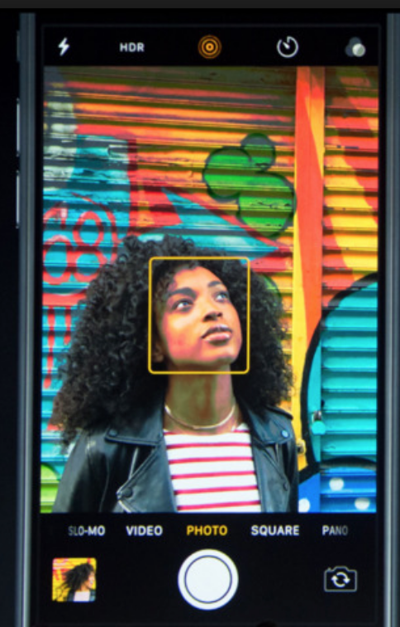
Motivation
Example: Image classification
2012
2013
2014
2015
Model size too large to be deployed to mobile phone or embedded system
model size = # of parameters * 4 Bytes

Slide 5
Motivation
Can we reduce model size without sacrificing performance loss for mobile phone or embedded application?
Reducing memory usage in neural network.
If so, how?
Locating where memory cost are from.
Applying different techniques (group-wise convolution, quantization, pruning, etc.) to reduce memory usage.

Slide 6
Content
Motivation
Where to focus on to compress
Different compressing methods
SEP-Net (My Research Work)
Experimental Results

Slide 7
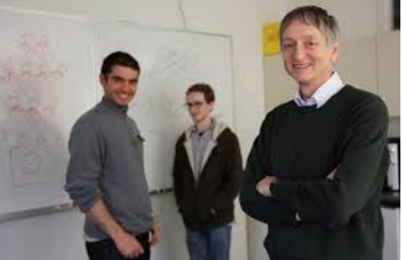
Locating parameters - History View
AlexNet (2012 ImageNet Competition Winner)
Breakthrough work.
Proposed and implemented in University of Toronto
Based on open source library CudaConvNet
Existing open source libraries such as Caffe, Tensorflow and others follows some design principle of CudaConvNet.

Slide 8

Locating parameters - History View
AlexNet
Highlights
Input: 3*224*224 size image
Output: 1000 size vector, using one index to indicate specific class
Structure: 5 convolution layers, 3 fully connected layers
Special feature: Two GPU cards are used
A. Krizhevsky, I. Sutskever, and G. Hinton. Imagenet classification with deep convolutional neural networks. In NIPS, 2012.

Slide 9
Locating parameters - History View
AlexNet
Compute # of parameters (first convolution layer)
96 filters of size 11*11*3 (3 colors of 11*11 window)
(11*11*3 + 1)*96 = 34944

Slide 10
Locating parameters - History View
AlexNet
# Parameters in Each Layer
Conv1 | 34.9K
Conv2 | 614.6K
Conv3 | 885.1K
Conv4 | 1.3M
Conv5 | 884.9K
FC6 | 37.7M
FC7 | 16.7M
FC8 | 4.1M
Total | 62.3M
Layer type | # Params | Percent
Conv | 3.7M | 6%
FC | 58.6M | 94%
Questions: Which layer should we focus on for reducing # of parameters?
250MB

Slide 11
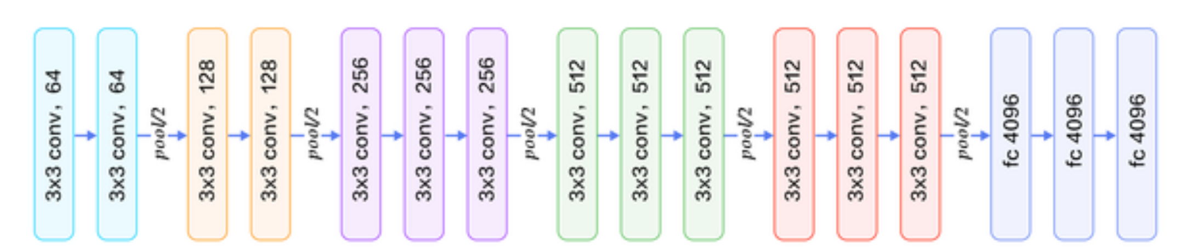
Locating parameters - History View
VGG-Net (2013 ImageNet Competition Winner)
13 layers convolution layers
3 layers fully connected layers
Researchers were focusing on improving on accuracy
CIFAR-10: validation accuracy of 93.56%
CIFAR-100: validation accuracy of 70.48%.
K. Simonyan and A. Zisserman. Very deep convolutional networks for large-scale image recognition. In ICLR, 2015

Slide 12
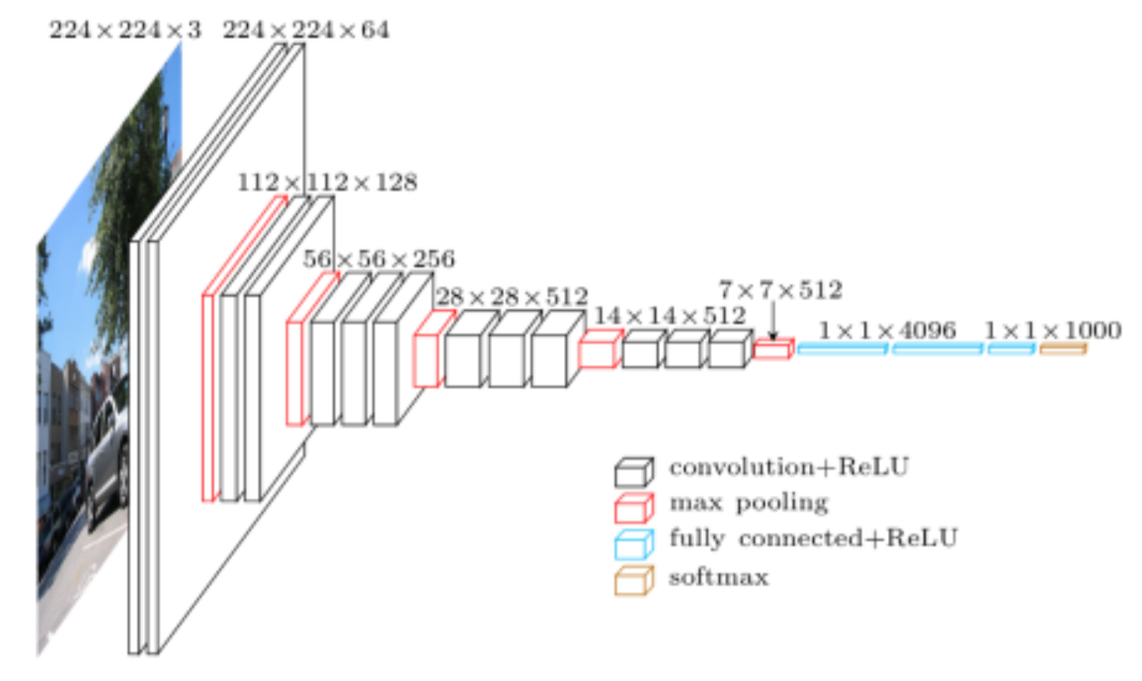
Locating parameters - History View
VGG-Net (2013 ImageNet Competition Winner)

Slide 13
Locating parameters - History View
VGG-Net (2013 ImageNet Competition Winner)
Conv1 | 1.7K
Conv2 | 36.8K
Conv3 | 73.7K
Conv4 | 147.4K
Conv5 | 294.9K
… | …
… | …
conv13 | 2.4M
FC14 | 102.77M
FC15 | 16.7M
FC16 | 4.1M
Total | 138M
Layer type | # Params | Percent
Conv | 14.4M | 10.4
FC | 123.6M | 89.6
Questions: Which layer should we focus on for reducing # of parameters?
450MB

Slide 14
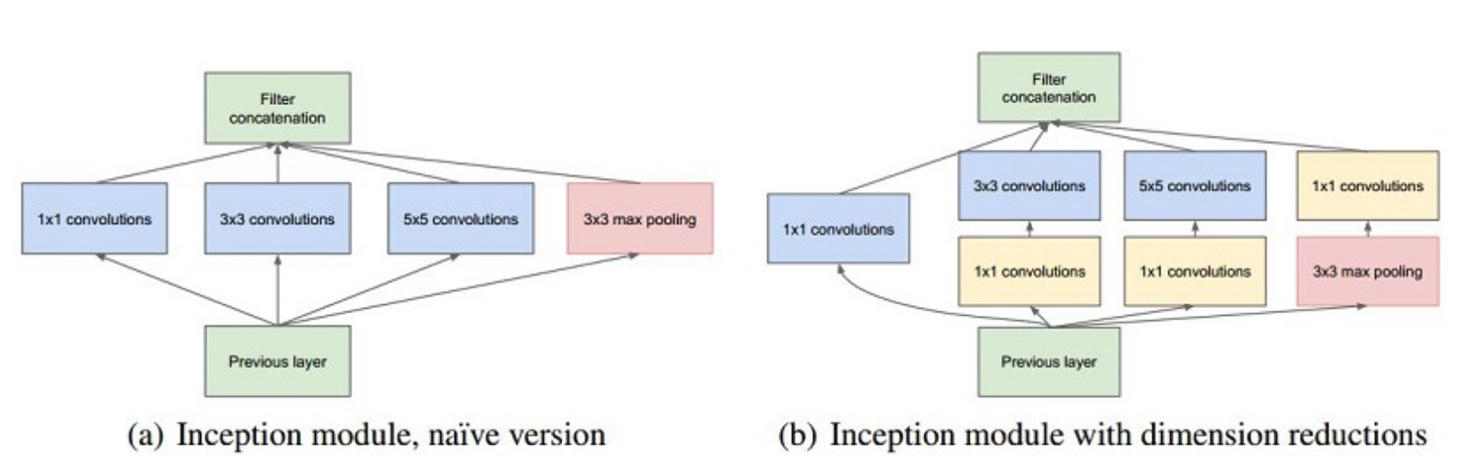
Locating parameters - History View
GoogleNet (2014 ImageNet Competition Winner)
Design base module: inception module
Multiple path compared with previous network structure
C. Szegedy, W. Liu, Y. Jia, P. Sermanet, S. Reed, D. Anguelov, D. Erhan, V. Vanhoucke, and A. Rabinovich. Going deeper with convolutions.

Slide 15
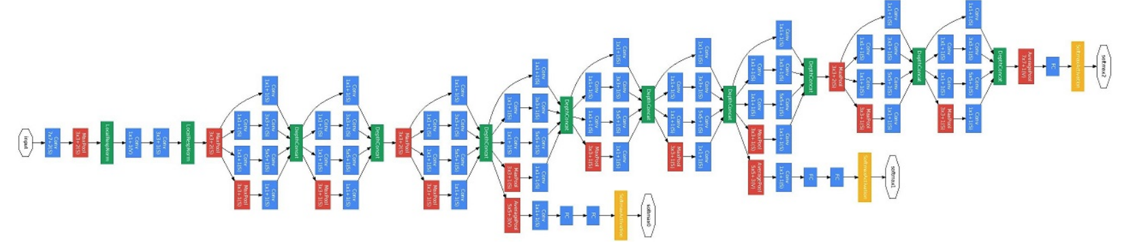
Locating parameters - History View
GoogleNet (2014 ImageNet Competition Winner)
9 inception modules
2 separable losses function
Remove fully connected layers
Model size reduce to 50MB
Loss layer
Loss layer

Slide 16
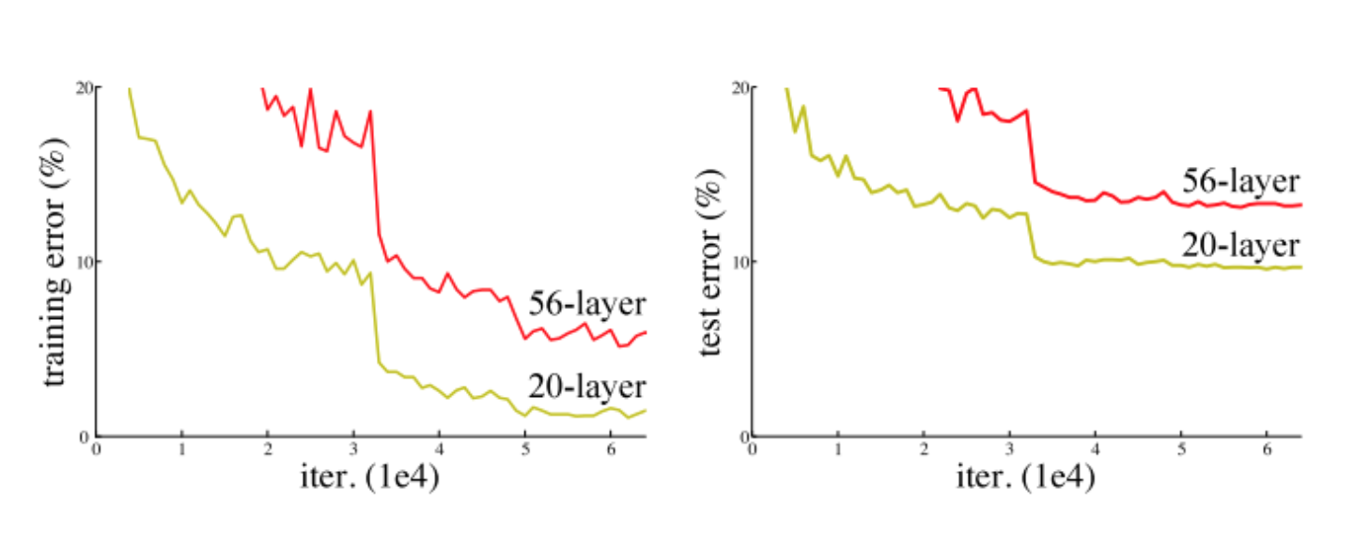
Locating parameters - History View
ResNet (2015 ImageNet Competition Winner)
More layers are not necessary to give better performance!
?
K. He, X. Zhang, S. Ren, and J. Sun. Deep residual learning for image recognition. In CVPR, 2016

Slide 17
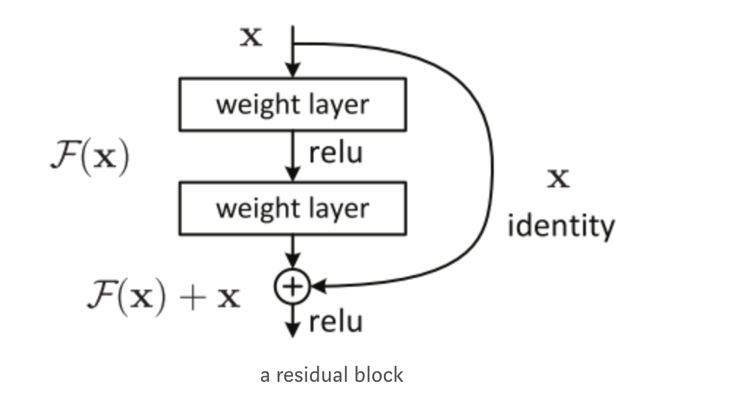
Locating parameters - History View
ResNet (2015 ImageNet Competition Winner)
Designed so-called residual block

Slide 18
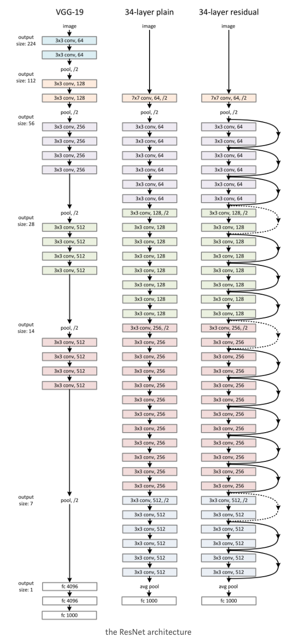
Locating parameters - History View
ResNet (2015 ImageNet Competition Winner)
152 convolutional layers and no fully connected layer
Skip layer
96.6% test accuracy, 200MB Model size

Slide 19
Summary from History
AlexNet → VGG-Net → GoogleNet → ResNet
Test accuracy are increasing to plateau (96.6%)
Reducing model size by removing fully connected layer
Still need to reduce model size but without losing performance
Questions: Which layer should we focus on for reducing # of parameters?

Slide 20
Content
Motivation
Where to focus on to compress
Compressing for Convolutional layer
SEP-Net (My Research Work)
Experimental Results

Slide 21
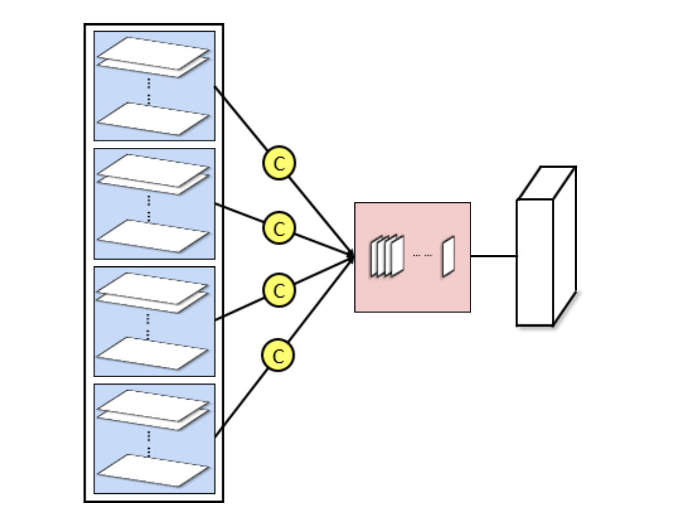
Targeting on convolution layer
Group-wise convolution
Why can we do this?
Take an example:
Input feature map: 16 x 48 x 48
Output feature map: 32 x 48 x 48
Filter size: 3 x 3
padding and stride: 1, 1
Original convolution:
16 X 11 X 11 X 32
Group wise convolution: (4 group)
16/4 x 11 x 11 x 32
Reducing # of parameters in convolution k times (k group convolution)

Slide 22
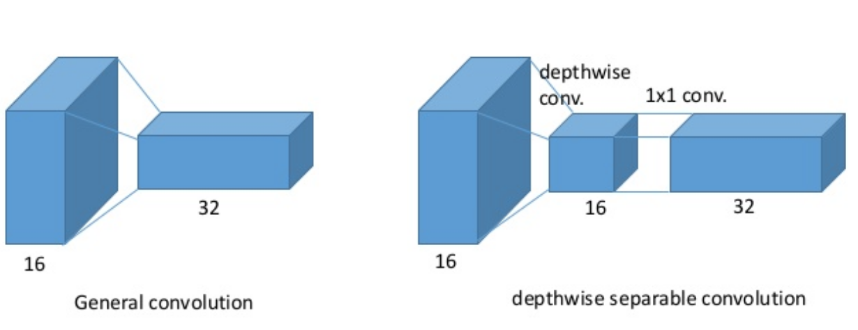
Targeting on convolution layer
Depth-wise separable convolution
Why can we do this?
https://www.slideshare.net/DongWonShin4/depthwise-separable-convolution

Slide 23
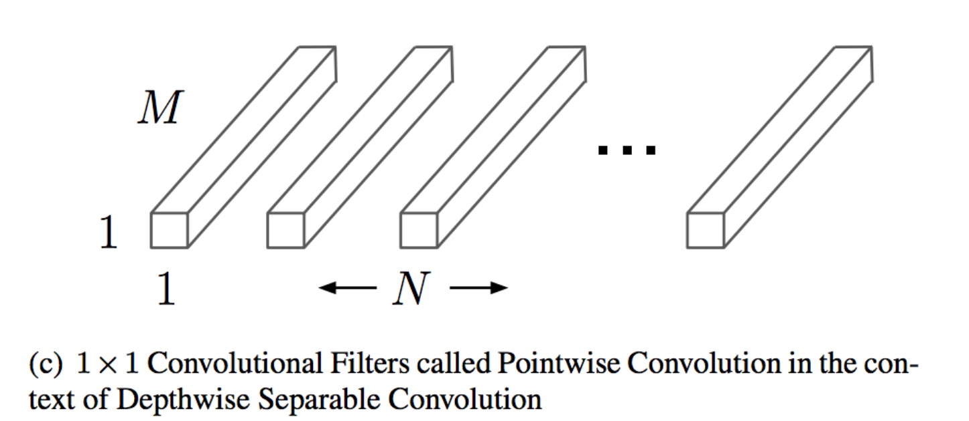
Targeting on convolution layer
Point wise convolution
1 x 1 filters serve as data transformation

Slide 24
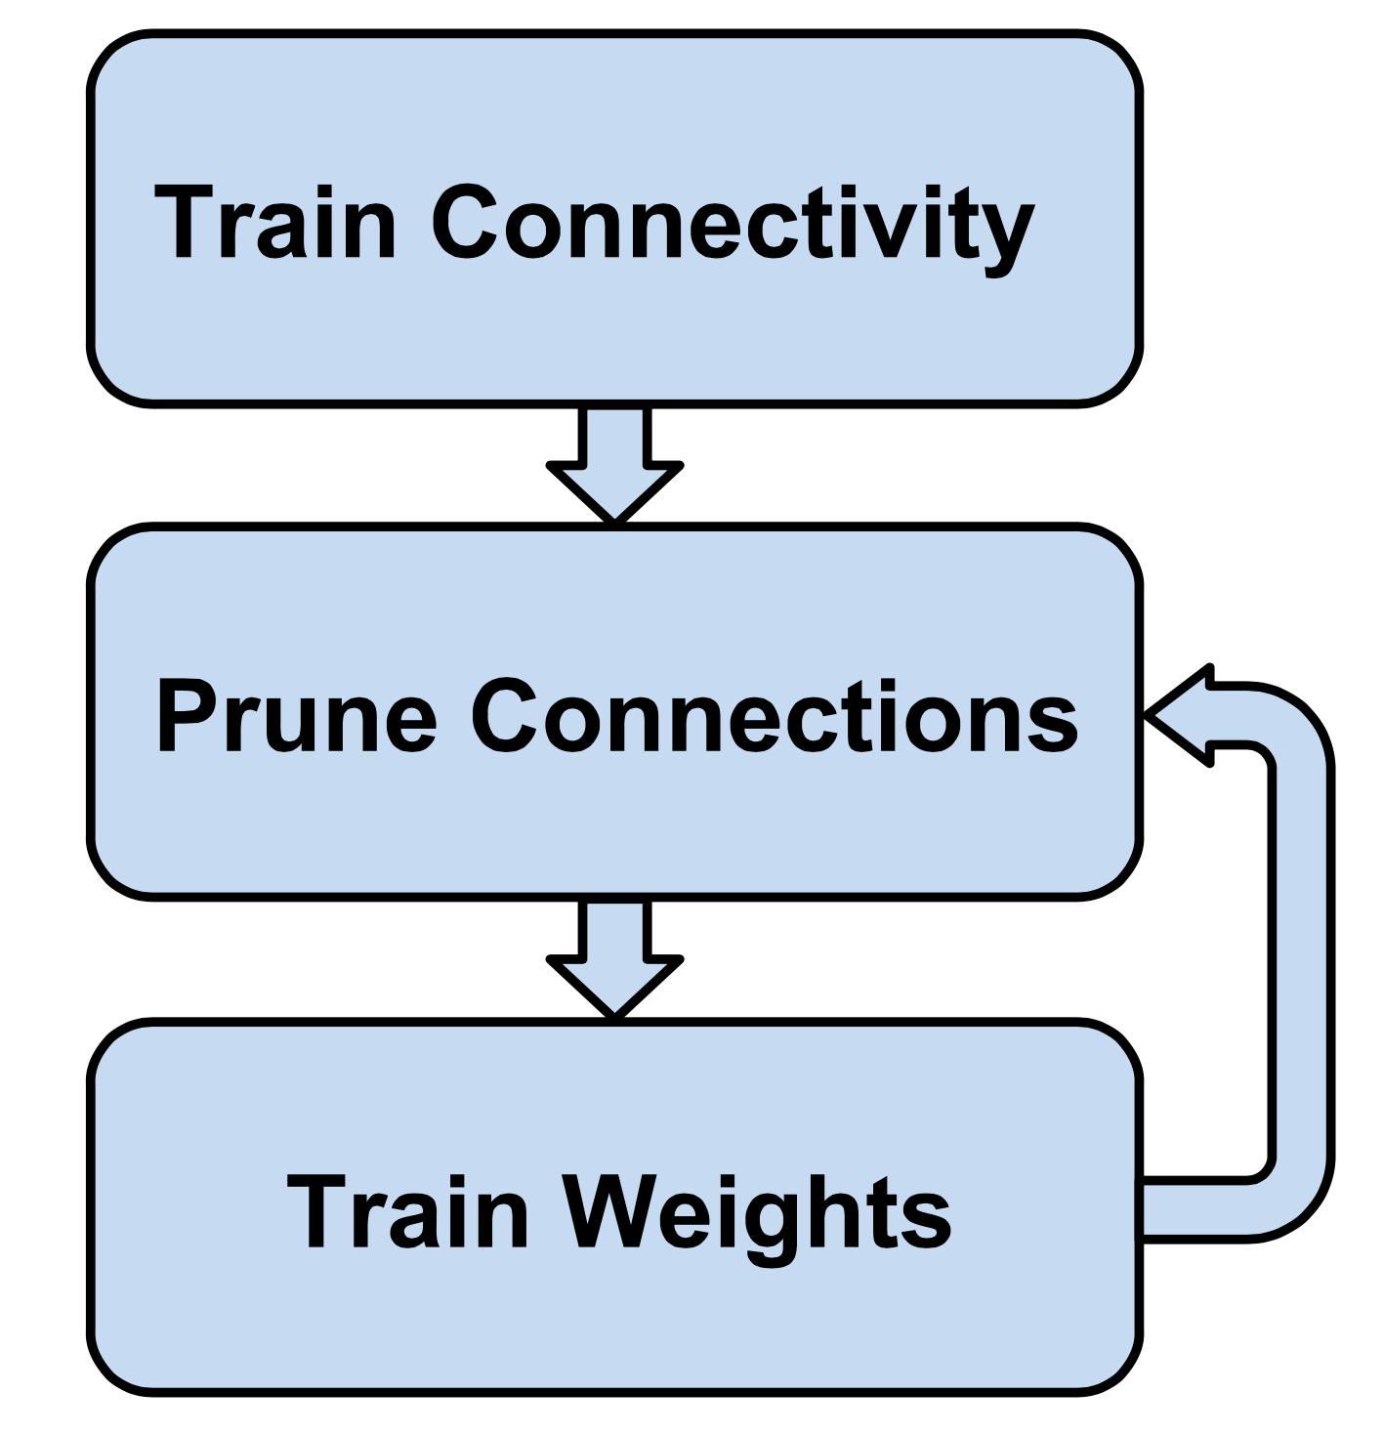
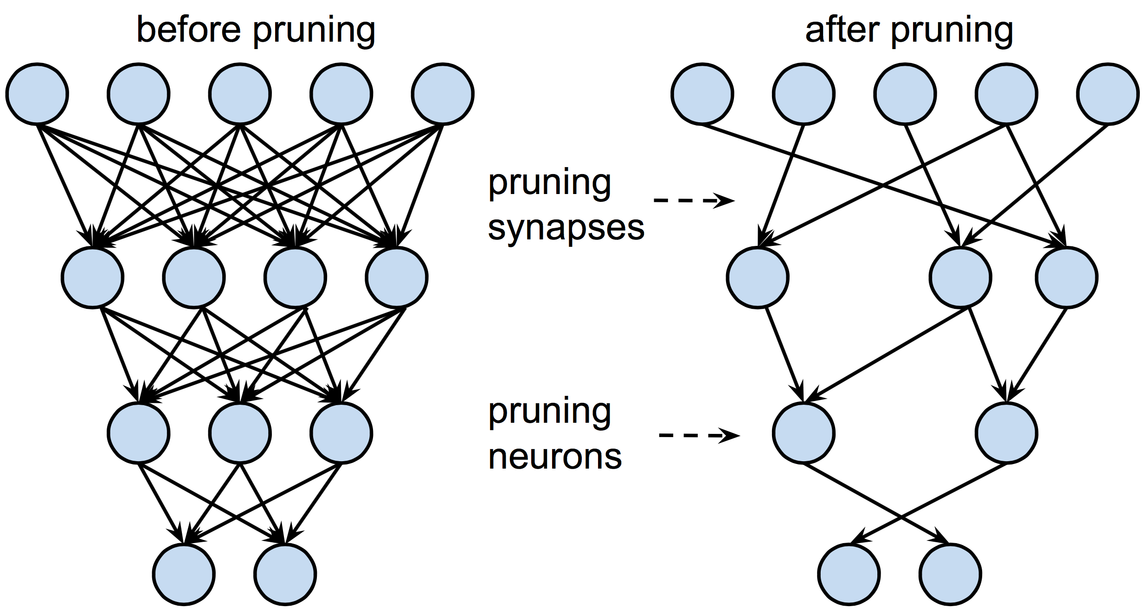
Weight Pruning
Magnitude-based Method: Iterative Pruning + Retraining
Han, Song, et al. "Learning both weights and connections for efficient neural network." NIPS. 2015.

Slide 25
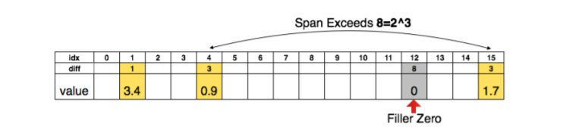
Weight Pruning Implementation
Before pruning: w_{ij} in W[i, j]
After pruning: w_{ij} in list L_{i} = { (j, w_{ij}) : j ≥ 0, w_{ij} > ε }
To reduce the memory, j can be replaced by a three-bits integer to store the next available position.
Example：Instead of L = { (1, 3.4), (4, 0.9), (15, 1.7) }, we use M = { (1, 3.4), (3, 0.9), (8, 0), (3, 1.7) }

Slide 26
Weight Pruning
Choose a neural network architecture
Train this network to converge
Pruning the weights based on threshold
Train the network to converge

Slide 27
Weight Pruning
Experiment Results
Network | Top-1 Error | Top-5 Error | # of Params | Compression
LeNet-300-100 Ref | 1.64% | - | 267K | 12X
LeNet-300-100 Pruned | 1.59% | - | 22K
LeNet-5 Ref | 0.80% | - | 431K | 12X
LeNet-5 Pruned | 0.77% | - | 36K
AlexNet Ref | 42.78% | 19.73% | 61M | 9X
AlexNet Pruned | 42.77% | 19.67% | 6.7M
VGG-16 Ref | 31.50% | 11.32% | 138M | 13X
VGG-16 Pruned | 31.34% | 10.88% | 10.3M
Han, Song, et al. "Learning both weights and connections for efficient neural network." NIPS. 2015.

Slide 28
Content
Motivation
Where to focus on to compress
Compressing for Convolutional layer
SEP-Net (My Research Work)
Experimental Results

Slide 29
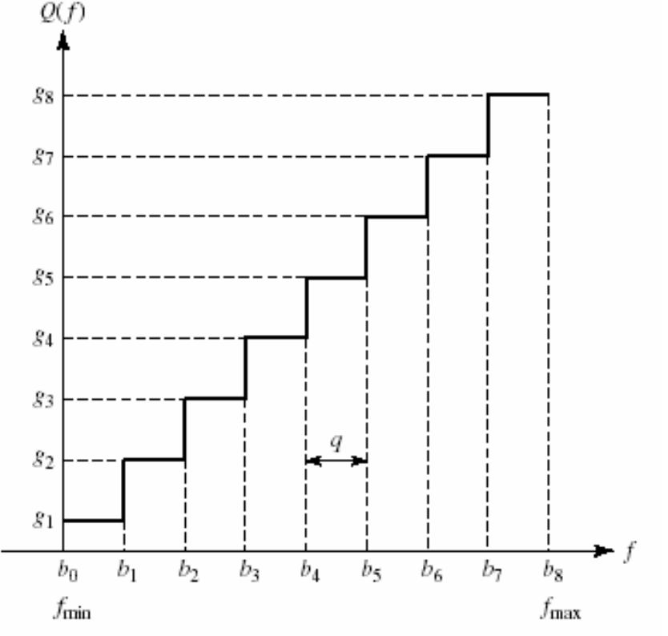
Targeting on convolution layer
Quantization
y
1
x
-1
General case
Quantization we used for simple purpose

Slide 30
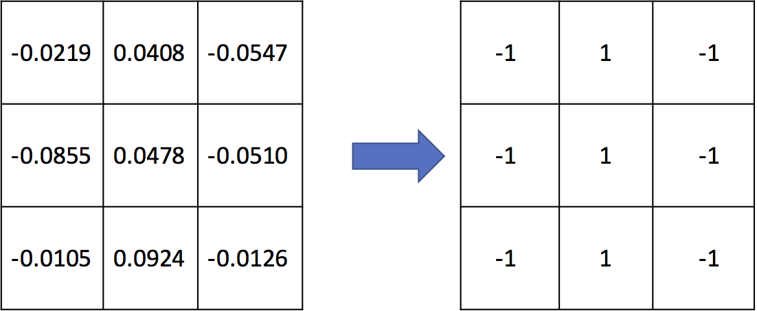
Pattern Binarization (Quantization)
k x k (k > 1) filters serve as spatial pattern extraction.
1 x 1 filters serve as data transformation.
Reduced memory usage of model dramatically.
A trained 3 x 3 filter from GoogleNet (left) and its binarized filter (right)

Slide 31
Pattern Binarization (Quantization)
How much can we reduce memory usage by the above ?
Before: 9 parameters → 9 x 4 Bytes
After: 9 parameters → 9 bits

Slide 32
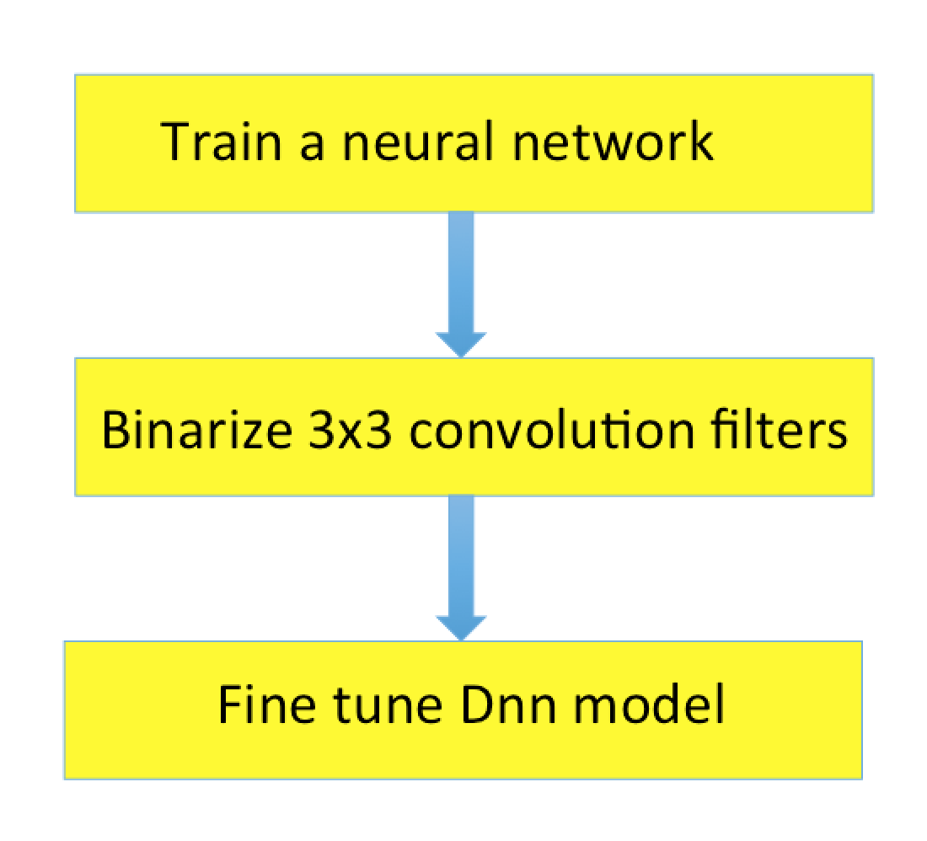
How to use pattern binarization?
Easily adopted to any successful networks structures such as GoogleNet, ResNet as following procedure:

Slide 33
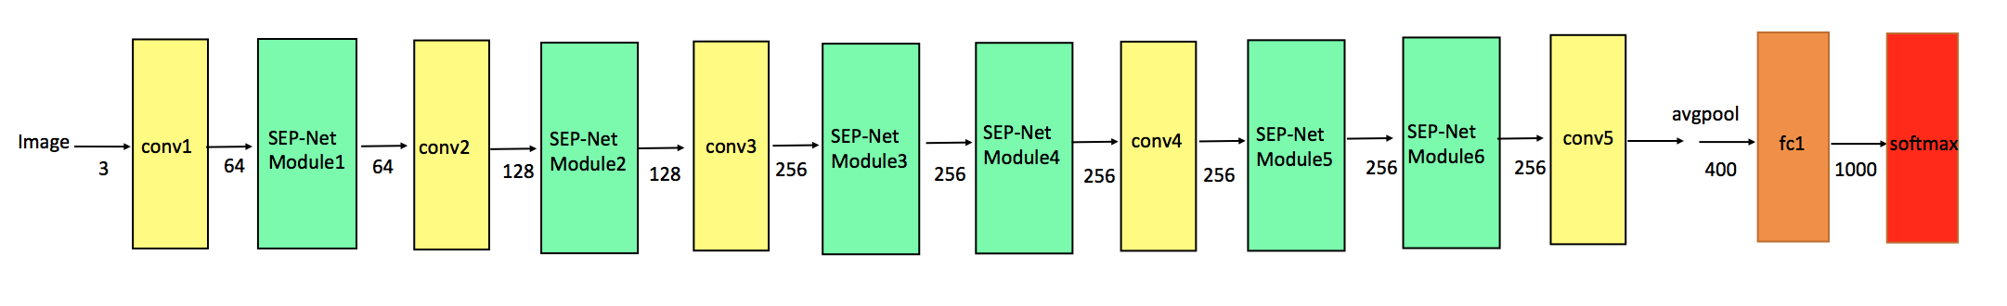
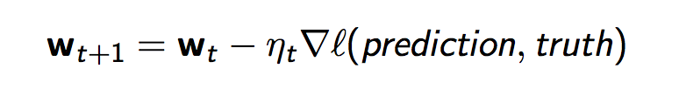
Implementation
Keep binarization filter same during fine-tuning.
Forward to compute loss
How ?
Backward to update gradient
set learning rate as 0

Slide 34
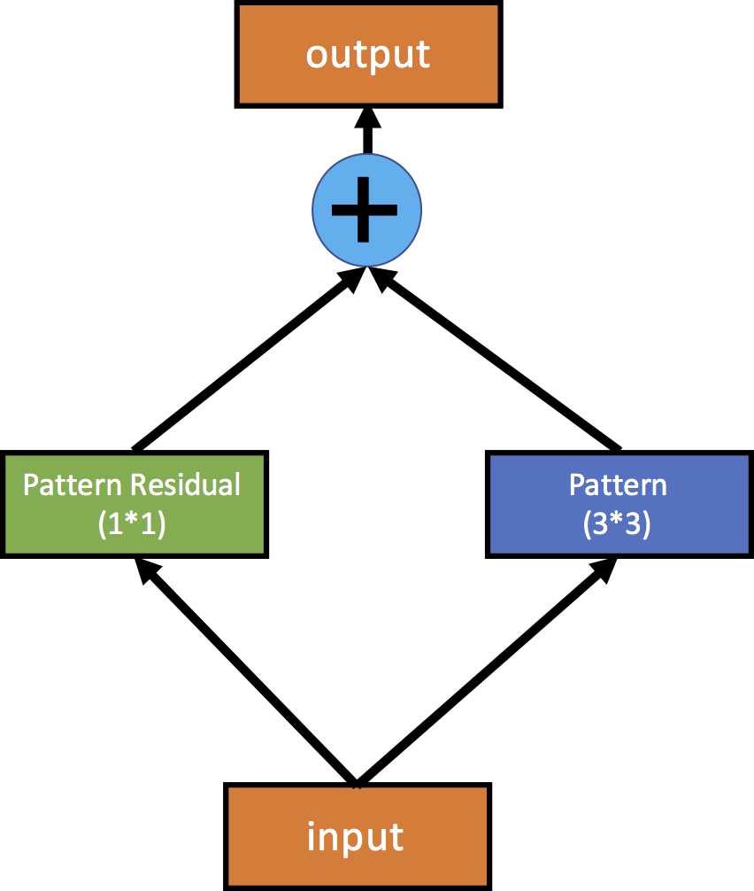
Pattern Residual Block
Features maps from 1 x 1 and k x k convolutions are added together.
Adding 1 x 1 convolutions offsets the change incurred by the binarization.

Slide 35
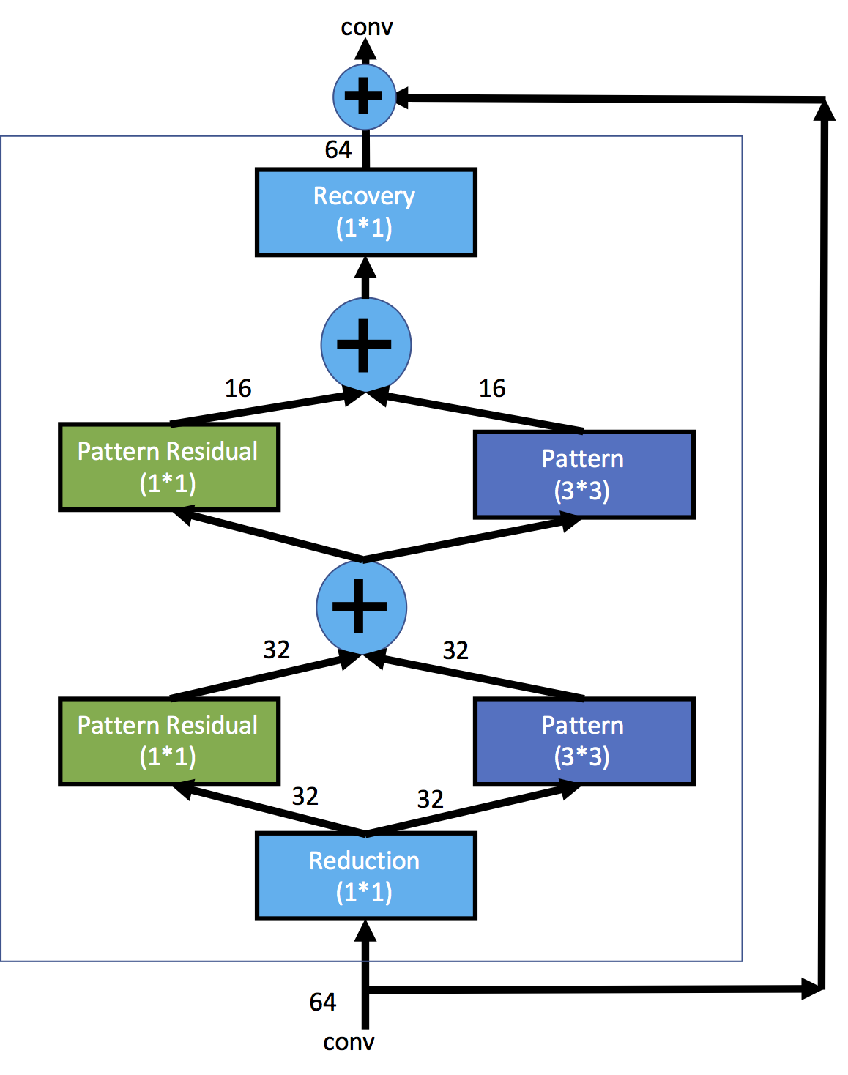
SEP-Net Module
1 x 1 convolution layers: dimension reduction.
2 PRB blocks with different output channels.
1 x 1 convolution layer: dimension recovery.
Skip connection.

Slide 36
The Proposed SEP-Net Structure
Proposed SEP-Net for mobile/embedded devices.
The designed SEP-Net has 1.3M parameters (5.2MB)

Slide 37
Content
Motivation
Where to focus on to compress
Compressing for Convolutional layer
SEP-Net (My Research Work)
Experimental Results

Slide 38
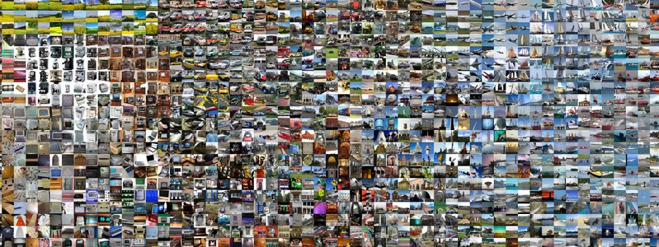
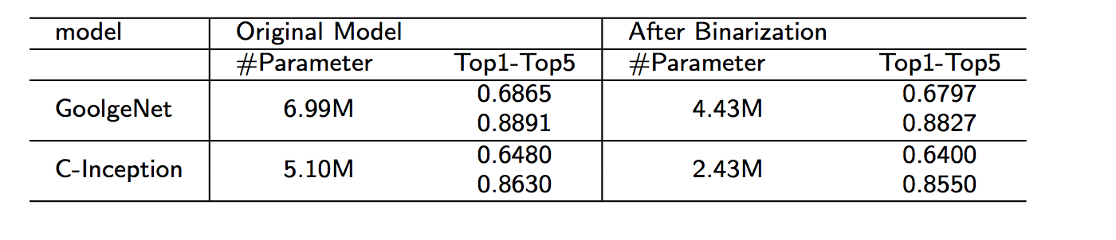
Experimental Results
1000 classes image recognition

Slide 39
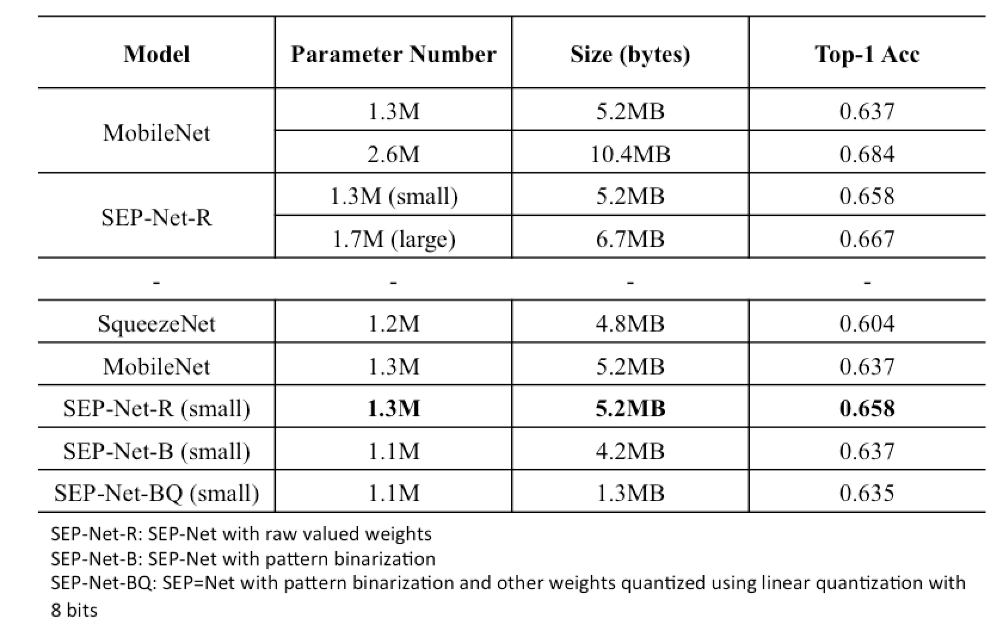
Experimental Results
The designed SEP-Net

Slide 40
Summary
From AlexNet to VGG-Net, GoogleNet, ResNet, test accuracy is steadily increasing to plateau
Reducing model size by removing FC layers
Further Reducing model size by targeting on convolution layer through group-wise convolution, depth separable convolution, quantization, pruning etc.

